Slide 1

Contoso Marketing Principals
Overview

Slide 2
Emotional Connection
Emotional connection is key
The right connection inspires brand loyalty
It’s time to break new ground
Notes:
Emotional connection is key
Research shows that virtually all strong opinions on packaging for our products and those of competitors are emotion-based
The right connection inspires brand loyalty
Change brand perception by getting personal
It’s about the person, not the package
Breaking new ground
Every aspect of the package should have a purpose
We need to get better about making choices

Slide 3
Project scope
Use Branding for Continuity
Convey Benefits of the New Release
Improve on the Past
Not Just More of the Same
Notes:
Develop packaging design and content for our 2012 product launch that reaches customers effectively in both physical and virtual storefronts.
Implement aspects of our branding for customer recognition and continuity.
Convey the unique benefits of our latest release.
Implement success and failure key takeaways from prior version packaging.
Minimize repetition with packaging from previous releases.

Slide 4
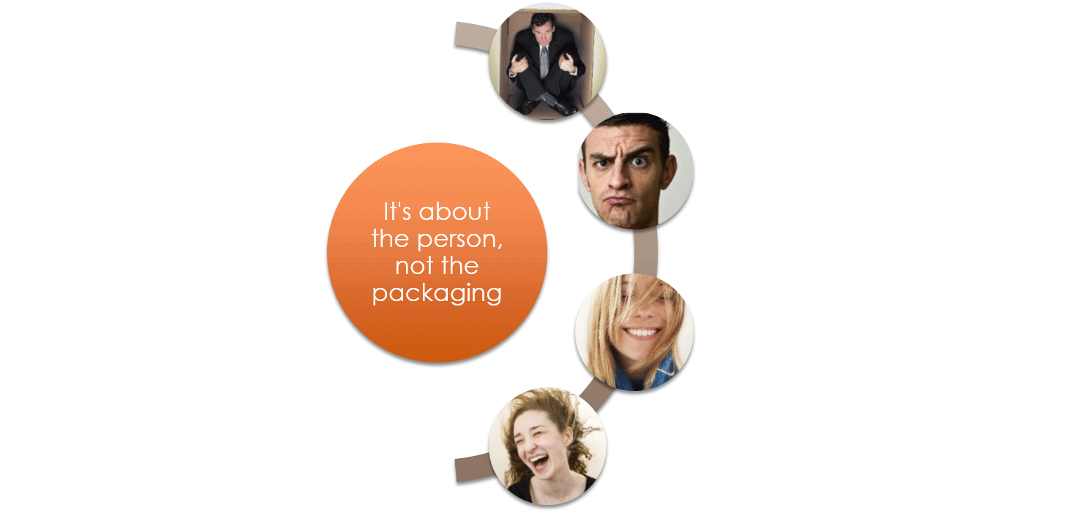
Fit the person—not the Box

